Slide 1
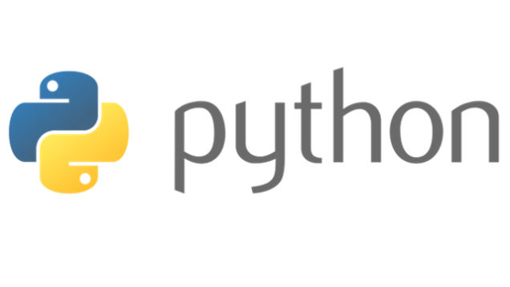
Variables, Keywords, Expressions, Statements

Slide 2
Program
Sequence of instructions that specify how to perform a computation.
Basic instructions in almost every program:
Input: Get data from keyboard, or file or some other device.
Output: Display data on the screen or send data to a file or other device.
Math: Perform basic mathematical operations like addition and multiplication.
Conditional Execution: Check for certain conditions and execute the appropriate sequence of statements.
Repetition: Perform some action repeatedly , usually with some variation

Slide 3
Debugging
Programming errors are called bugs.
Process of tracking bugs and correct them is called debugging.
Types of Errors
Syntax Errors
Run Time Errors (Exceptions)
Semantic Errors

Slide 4
Formal and Natural Languages
Natural Languages are the languages that people speak, such as English, Spanish, French. They were not designed by people; they evolved naturally.
Formal Languages are languages that are designed by people for specific applications.
Programming languages are formal languages that have been designed to express computations.
Parsing is a process to figure out what the structure of the sentence is.
Notes:
So ,Guys how many of you are afraid of programming ???? , who think that coding is the most difficult thing to do ??? Pick one of them and ask him/her the recipe of Maggi or tea …

Slide 5
Difference between Natural and Formal Languages
Ambiguity: Natural languages are full of ambiguity.
Formal languages are designed to be nearly or completely unambiguous.
Redundancy: Natural languages are more redundant as compared to formal languages.
Literalness: Natural languages are full of idiom and metaphor. If I say, “The other shoe fell," there is probably no shoe and nothing falling. Formal languages mean exactly what they say.

Slide 6
Data types in Python
Numbers
Tuples
Strings
List
Sets
Dictionary

Slide 7
Variable Expressions and Statements
Value is a one of the fundamental thing, that a program manipulates.
Variable is a name that refers to a value.
The assignment statement creates new variables and gives them values:
>>> message = "What's up, Doc?"
>>> n = 17
>>> pi = 3.14159
A common way to represent variables on paper is to write the name with an arrow pointing to the variable's value. This kind of representation is called a state diagram.

Slide 8
Keywords
Keywords define the language’s rules and structure and they can’t be used as variable names.
Python has twenty-nine keywords:
and def exec if not return
assert del finally import or try
break elif for in pass while
class else from is print yield
continue except global lambda raise

Slide 9
Variable
Variable names must be meaningful.
It contains both numbers and letters, but they have to begin with a letter.
Case sensitive.
The underscore (_) character can appear in a name.
Eg.
>>>76trombones = "big parade“ >>> more$ = 1000000
SyntaxError: invalid syntax SyntaxError: invalid syntax
>>> class = "Computer Science 101“
SyntaxError: invalid syntax

Slide 10
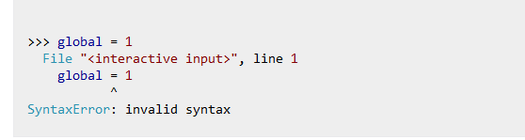
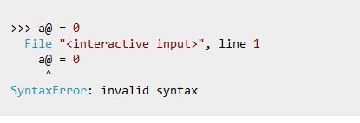
Rules for writing identifiers in Python
Identifiers can be a combination of letters in lowercase (a to z) or uppercase (A to Z) or digits (0 to 9) or an underscore (_). Names like myClass, var_1 and print_this_to_screen, all are valid example.
An identifier cannot start with a digit. 1variable is invalid, but variable1 is perfectly fine.
Keywords cannot be used as identifiers.
We cannot use special symbols like !, @, #, $, % etc. in our identifier.
Identifier can be of any length.

Slide 11
Statements
A statement is an instruction that the Python interpreter can execute.
When you type a statement on the command line, Python executes it and displays the result, if there is one.
A script usually contains a sequence of statements. If there is more than one statement, the results appear one at a time as the statements execute.

Slide 12
Evaluating Expressions
An expression is a combination of values, variables, and operators.
If you type an expression on the command line, the interpreter evaluates it and displays the result:
>>> 1 + 1
2
A value all by itself is considered an expression, and so is a variable.
>>> 17 >>> x
17 2
Notes:
We all know YouTube as the place to upload cat videos and fails. As one of the most popular websites in existence, it provides us with endless hours of video entertainment. The Python programming language powers it and the features we love.

Slide 13
Operators and Operands
Operators are special symbols that represent computations like addition and multiplication.
The values the operator uses are called operands
When both of the operands are integers, the result must also be an integer, and by convention, integer division always rounds down.
+, -, *, /, %, **, //
Notes:
DropBox started the online document storing revolution that has become part of daily life. We now store almost everything in the cloud. Dropbox allows us to store, sync, and share almost anything using the power of Python.

Slide 14
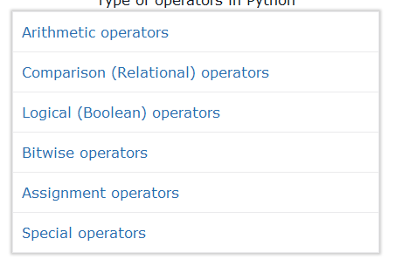
Type of operators in Python

Slide 15
Arithmetic operators
When more than one operator appears in an expression, the order of evaluation depends on the rules of precedence.
The acronym PEMDAS is a useful way to remember the order of operations:
Parentheses have the highest precedence and can be used to force an expression to evaluate in the order you want.
Exponentiation has the next highest precedence.
Multiplication and Division have the same precedence, which is higher than Addition and Subtraction, which also have the same precedence.
Operators with the same precedence are evaluated from left to right.
Notes:
Survey Monkey is the largest online survey company. They can handle over one million responses every day on their rewritten Python.

Slide 16
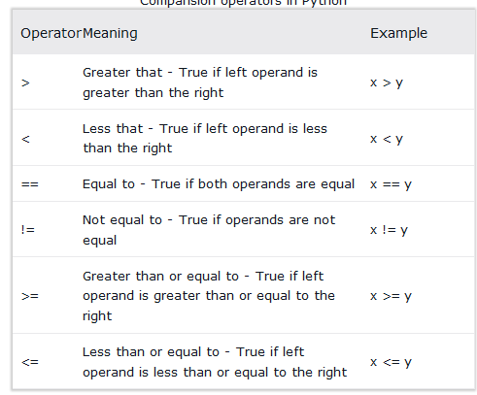
Comparison operators
Comparison operators are used to compare values. It either returns True or False according to the condition.

Slide 17
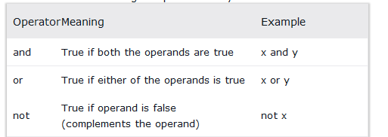
Logical operators
Logical operators are the and, or, not operators.

Slide 18
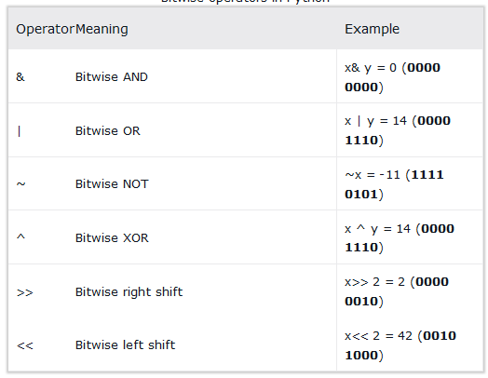
Bitwise operators
Bitwise operators act on operands as if they were string of binary digits. It operates bit by bit, hence the name. For example, 2 is 10 in binary and 7 is 111.
Let x = 10 (0000 1010 in binary) and y = 4 (0000 0100 in binary)

Slide 19
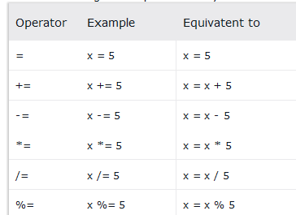
Assignment operators

Slide 20
Operations on Strings
Mathematical operations can’t be performed on strings, even if the strings look like numbers.
the + operator represents concatenation.
For Example:
fruit = "banana"
bakedGood = " nut bread“
print fruit + bakedGood
The * operator also works on strings; it performs repetition.
For eg:
"Fun"*3 is "FunFunFun"
Notes:
Python also provides the power behind the most popular search engine in the world – Google. The programming language can handle the traffic and computing needs of the search engine and its connected apps.

Slide 21
Composition
One of the most useful features of programming languages is their ability to take small building blocks and compose them
Comments
It is a good idea to add notes to your programs to explain in natural language what the program is doing. These notes are called comments.
they are marked with the # symbol:
For eg:
# compute the percentage of the hour that has elapsed
percentage = (minute * 100) / 60
Notes:
Quora is the number one place online to ask a question and receive answers from a community of individuals. On their Python website relevant results are answered, edited, and organized by these community members.

Slide 22
Python Statement
Python Indentation
Python Comments

Slide 23
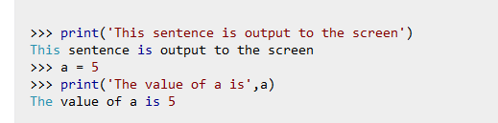
Python language provides numerous built-in functions that are readily available to us at the Python prompt. Some of the functions like input() and print() are widely used for standard input and output operations respectively.
Output
We use the print() function to output data to the standard output device (screen).

Slide 24
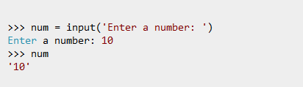
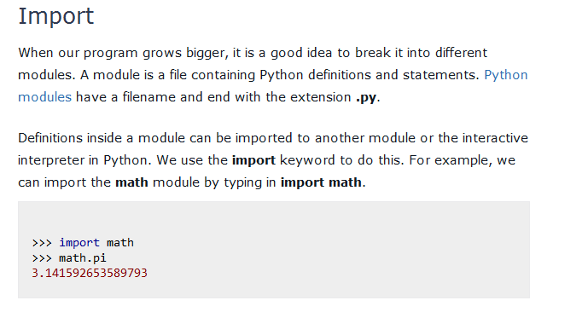
Input

Slide 25
calculator

